Slide 1
Basics of Programming
(Introduction to Python)
Almaz Turginbekov
MSc in Computer Science and Engineering
Graduate School of Science and Technology
Niigata University
Teacher East-Kazakhstan Technical University

Slide 2
About me
Name: Almaz Turginbekov (Network Engineer, Researcher, Data Scientist)
Education: BSc in Software Engineering, MSc in Computer Science and Engineering
Professional Background: Network Engineering; Academic Researcher
Research Areas: AI in Agriculture, Aquaculture, Computer Vision, Data Analysis, Network
Fun Facts: Gaming, K&J-pop, MBTI: INTJ
Contacts: LinkedIn, Telegram (AlmazCzip), Email: turginbekovalmaz@gmail.com,

Slide 3
Icebreaker
Introduction: Your name and where are you from?
Background: Hobbies and something interesting
Motivation: Why did you choose this major?
Goals: What's your expectation from this course?

Slide 4
What is Python?
Python is an interpreted, object-oriented, high-level programming language with dynamic semantics. Its high-level built in data structures, combined with dynamic typing and dynamic binding, make it very attractive for Rapid Application Development, as well as for use as a scripting or glue language to connect existing components together.
It is used for:
  web development (server-side),
  software development,
  mathematics,
  system scripting.

Slide 5
Some useless history of Python
Python is an interpreted high-level programming language for general-purpose programming. Created by Guido van Rossum and first released in 1991, Python has a design philosophy that emphasizes code readability, notably using significant whitespace. It provides constructs that enable clear programming on both small and large scales. In July 2018, Van Rossum stepped down as the leader in the language community after 30 years.

Slide 6
What can Python do?
Python can be used on a server to create web applications.
Python can be used alongside software to create workflows.
Python can connect to database systems. It can also read and modify files.
Python can be used to handle big data and perform complex mathematics.
Python can be used for rapid prototyping, or for production-ready software development.

Slide 7
Why Python?
Python works on different platforms (Windows, Mac, Linux, Raspberry Pi, etc).
Python has a simple syntax similar to the English language.
Python has syntax that allows developers to write programs with fewer lines than some other programming languages.
Python runs on an interpreter system, meaning that code can be executed as soon as it is written. This means that prototyping can be very quick.
Python can be treated in a procedural way, an object-oriented way or a functional way.

Slide 8
Python Apps
Instagram (Django Framework)
Spotify (Recommendation Algorithm)
Netflix (Recommendation Algorithm)
Pinterest (core)
Reddit (core)
Facebook (Meta) (Tornado web framework)
Dropbox (core)
Uber (Tornado web framework)

Slide 9
Python logic workflow
The Python interpreter is a program that directly executes Python code. The most common interpreter, CPython, works by:
Compiling source code into an intermediate format called bytecode.
Executing the bytecode on the Python Virtual Machine (PVM).
This "interpreted" nature allows for rapid prototyping and execution of code as soon as it is written.

Slide 10
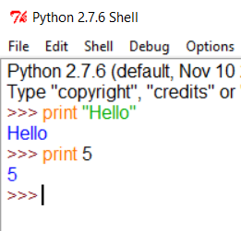
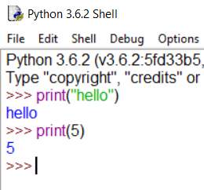
Python installation
https://www.python.org/downloads/
Recommended version Python 3.12 or 3.9. Be cautious as you need to add python interpreter to your path variables
IDE - Integrated Development Environment
VS Code or PyCharm
Python 2.7.*
Python 3.*

Slide 11
Environment for development
Side development kits:
  Web resource – www.pythonanywhere.com
    Free server with some limited space
  PyCharm - https://www.jetbrains.com/pycharm/
    For the professional purposes, “kind of”
  Jupyter Notebook - http://jupyter.org/
    Useful notebook to start a local server and keep your scripts
  Google Colab - https://colab.google/
    Jupyter notebook server by google.

Slide 12
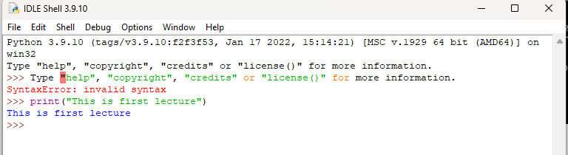
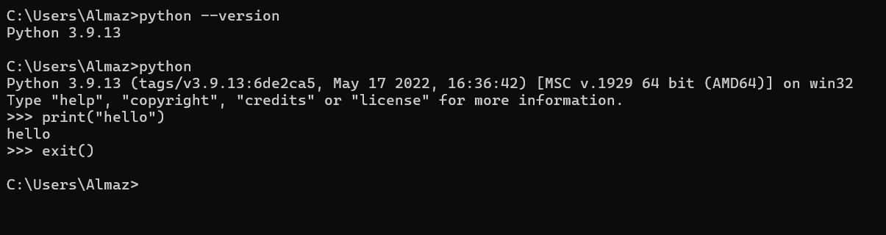
Environments

Slide 13
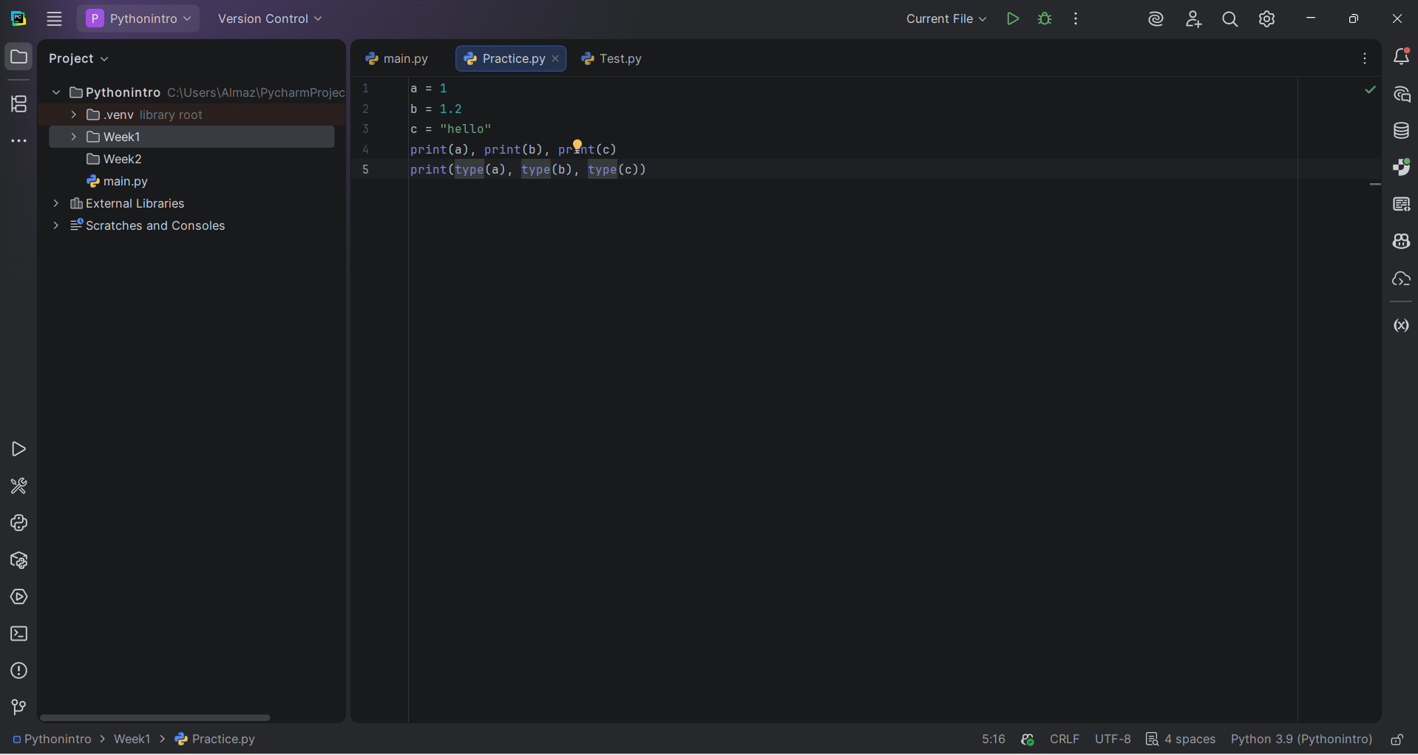
Environments 2

Slide 14
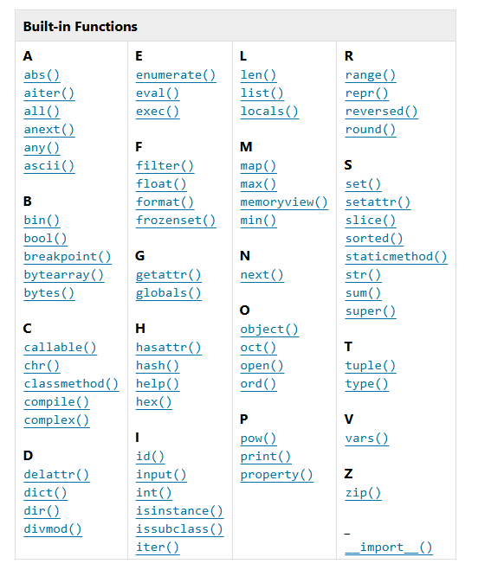
Built in instruments and pip
https://docs.python.org/3.12/library/functions.html
pip is the tool to install
new libraries to your
existing python
environment

Slide 15
Useful links
Check these web resources if you are interested (I hope you are):
  www.google.com
  www.python.org
  https://codingbat.com/python
  https://www.practicepython.org/

Slide 16
Python Syntax
a = 1
b = 1.2
c = "hello"
print ("Hello World")
print(a), print(b), print(c)
print(type(a), type(b), type(c))

Slide 17
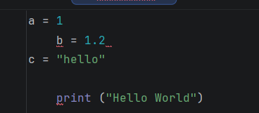
Python Indentation
Indentation refers to the spaces at the beginning of a code line.
Where in other programming languages the indentation in code is for readability only, the indentation in Python is very important.
Python uses indentation to indicate a block of code.

Slide 18
Python Statements
Statements
A computer program is a list of "instructions" to be "executed" by a computer.
In a programming language, these programming instructions are called statements.
The following statement prints the text "Python is fun!" to the screen:
print("Python is fun!")
In Python, a statement usually ends when the line ends. You do not need to use a semicolon (;) like in many other programming languages (for example, Java or C).

Slide 19
MultiStatements
Most Python programs contain many statements.
The statements are executed one by one, in the same order as they are written:
print("Hello World!")
print("Have a good day.")
print("Konnichiwa!")

Slide 20
Semicolons
Semicolons are optional in Python. You can write multiple statements on one line by separating them with ; but this is rarely used because it makes it hard to read:
print("Hello"); print("How are you?"); print("Bye bye!")
However, if you put two statements on the same line without a separator (newline or ;), Python will give an error:
print("Python is fun!") print("Really!")
SyntaxError: invalid syntax

Slide 21
print()
Probably, the most common function that you (will) use in Python.
Built-In function in Python.
  print “Some Text” – python 2.*.*
  print(“Another Text”) – python 3.*.*
Arguments:
  print(*object, sep=“”, end='\n', file=sys.stdout, flush=False)
Example:
  print(“Can someone lend me”, “2 million dollars”, sep=“PLEASE”, end=“?!”)

Slide 22
Output formatting
You can customize your output.
So how can you do it?
Several ways to do it:
Example 1:
  name = “Reze”
  print(“My name is %s” % name)

Slide 23
Output formatting
Example 2:
  name = “Gintoki”
  surname = “Sakata”
  print(“My full name is %s %s” % (surname, name))
Example 3:
  a = 10
  b = 10
  print(“Sum of %i and %i is equal to “ % (a,b), a+b)

Slide 24
Output formatting
Example 4:
.format(...) method
print(“You will {1} it useful, {0} you?”.format(“won't”, “find”))
Some keys in formatting for the %
Full table is given in the next slide

Slide 25
Table of conversion using %
Conversion | Meaning
d | Signed integer decimal.
i | Signed integer decimal.
o | Unsigned octal.
u | Obsolete and equivalent to 'd', i.e. signed integer decimal.
x | Unsigned hexadecimal (lowercase).
X | Unsigned hexadecimal (uppercase).
e | Floating point exponential format (lowercase).
E | Floating point exponential format (uppercase).
f | Floating point decimal format.
F | Floating point decimal format.
g | Same as "e" if exponent is greater than -4 or less than precision, "f" otherwise.
G | Same as "E" if exponent is greater than -4 or less than precision, "F" otherwise.
c | Single character (accepts integer or single character string).
r | String (converts any python object using repr()).
s | String (converts any python object using str()).
% | No argument is converted, results in a "%" character in the result.

Slide 26
Math operators
Operation | Syntax | Function
Addition | a + b | add(a, b)
Concatenation | seq1 + seq2 | concat(seq1, seq2)
Containment Test | obj in seq | contains(seq, obj)
Division | a / b | truediv(a, b)
Division | a // b | floordiv(a, b)
Bitwise And | a & b | and_(a, b)
Bitwise Exclusive Or | a ^ b | xor(a, b)
Bitwise Inversion | ~ a | invert(a)
Bitwise Or | a | b | or_(a, b)
Exponentiation | a ** b | pow(a, b)
Identity | a is b | is_(a, b)
Identity | a is not b | is_not(a, b)
Indexed Assignment | obj[k] = v | setitem(obj, k, v)
Indexed Deletion | del obj[k] | delitem(obj, k)
Indexing | obj[k] | getitem(obj, k)
Left Shift | a << b | lshift(a, b)
Modulo | a % b | mod(a, b)

Slide 27
Math operators 2
Operation | Syntax | Function
Multiplication | a * b | mul(a, b)
Matrix Multiplication | a @ b | matmul(a, b)
Negation (Arithmetic) | - a | neg(a)
Negation (Logical) | not a | not_(a)
Positive | + a | pos(a)
Right Shift | a >> b | rshift(a, b)
Slice Assignment | seq[i:j] = values | setitem(seq, slice(i, j), values)
Slice Deletion | del seq[i:j] | delitem(seq, slice(i, j))
Slicing | seq[i:j] | getitem(seq, slice(i, j))
String Formatting | s % obj | mod(s, obj)
Subtraction | a - b | sub(a, b)
Truth Test | obj | truth(obj)
Ordering | a < b | lt(a, b)
Ordering | a <= b | le(a, b)
Equality | a == b | eq(a, b)
Difference | a != b | ne(a, b)
Ordering | a >= b | ge(a, b)

Slide 28
Data input
To input data you can use a ready function called “input”:
Example:
  a = input(“Ask a user to input something”) (for python 3.*)
    Returns only string
  b = raw_input(“Ask a user to input something”) (for python 2.*)
    Return only strings too
  b = input(“Ask a user to input something”) (for python 2.*)
    Returns a data type that was entered

Slide 29
Adding comments to your code
Commenting code is a good way of programming
Commenting helps to understand your code for a person who will work with/after you
To comment your code you can use:
# - sharp (octothorpe), comments one line of code
''' Something ''' – triple quotes to open and another three to close the commenting; comments several lines

